Slide 1
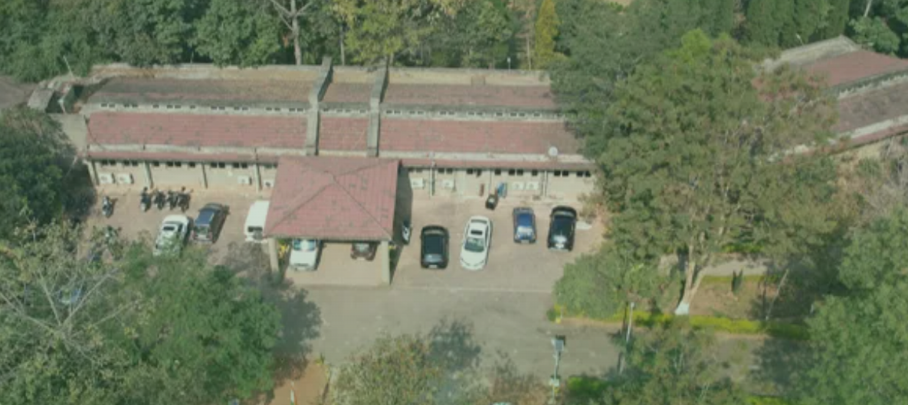
Demo photo

Slide 2
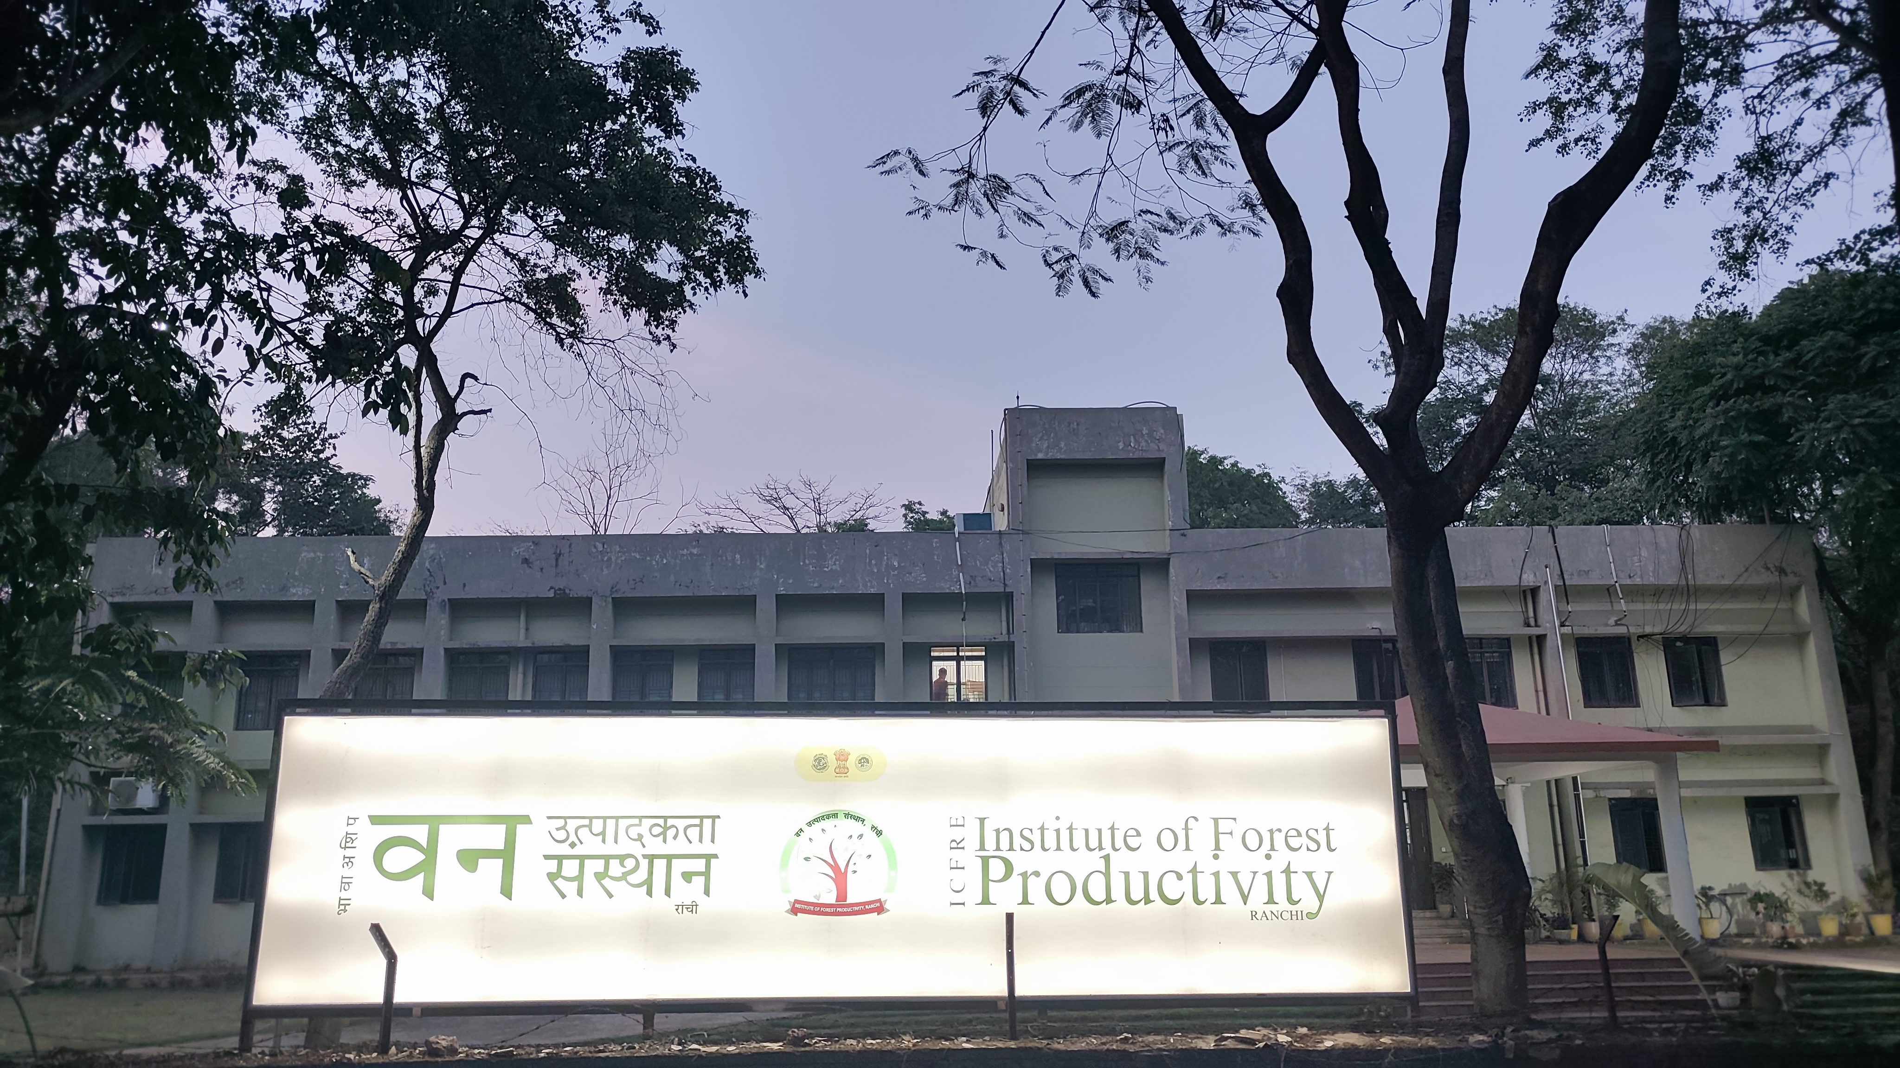
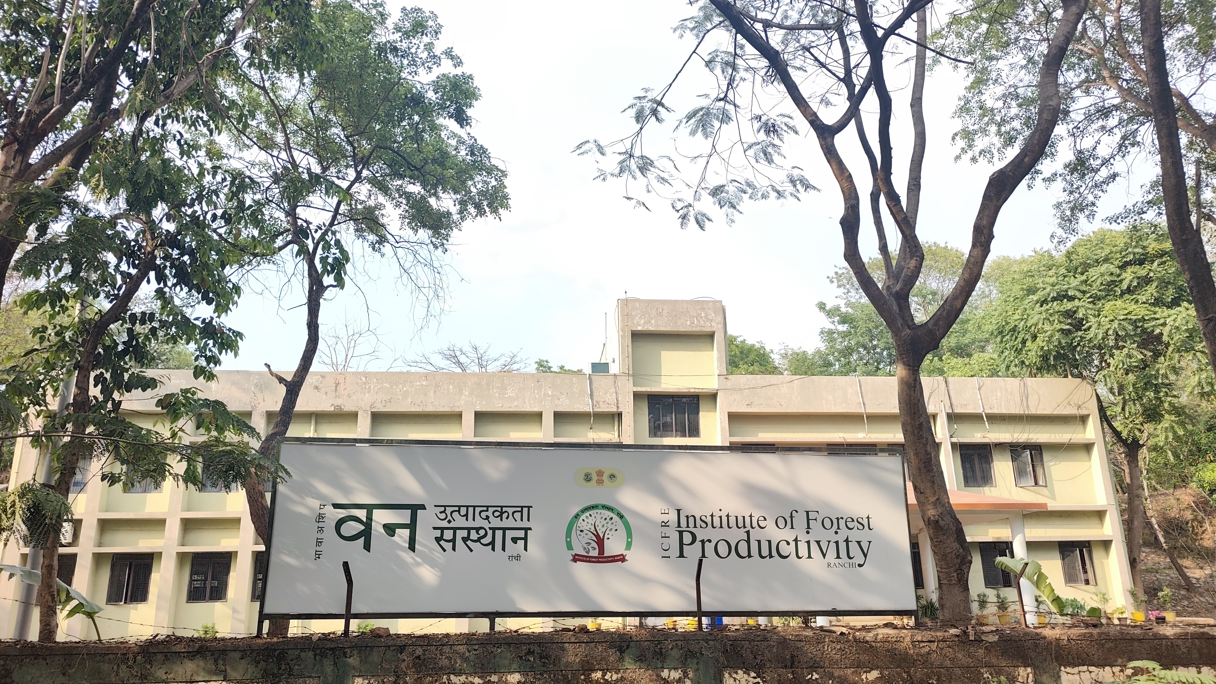
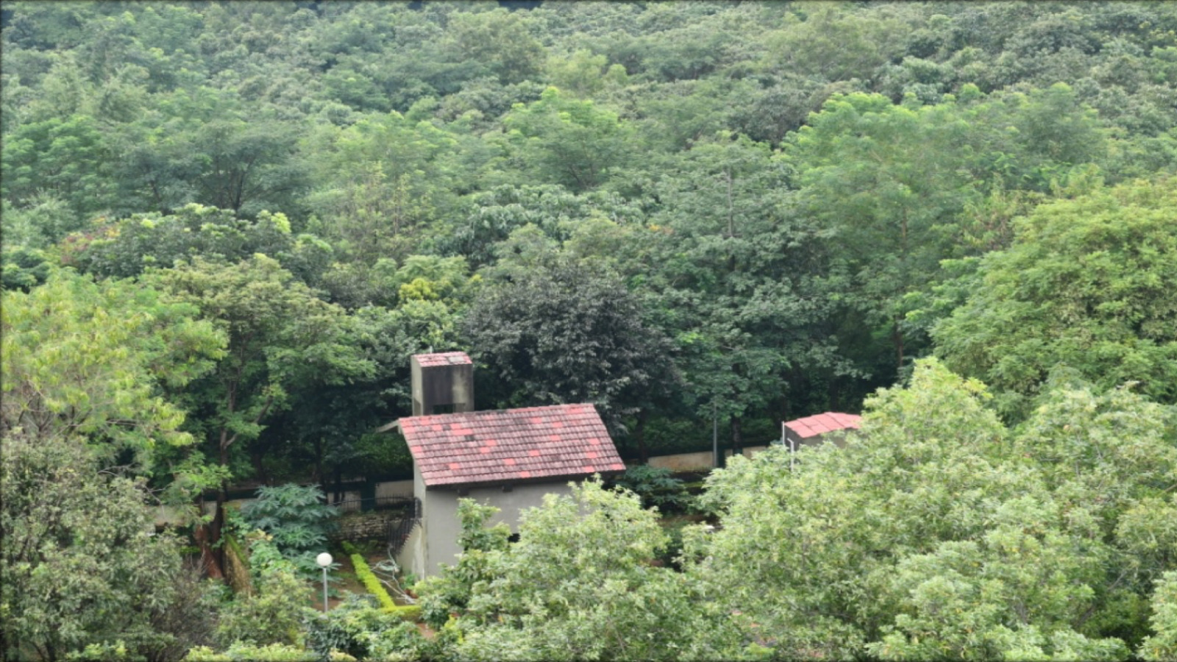
Actual
Notes:
Choose one

Slide 3
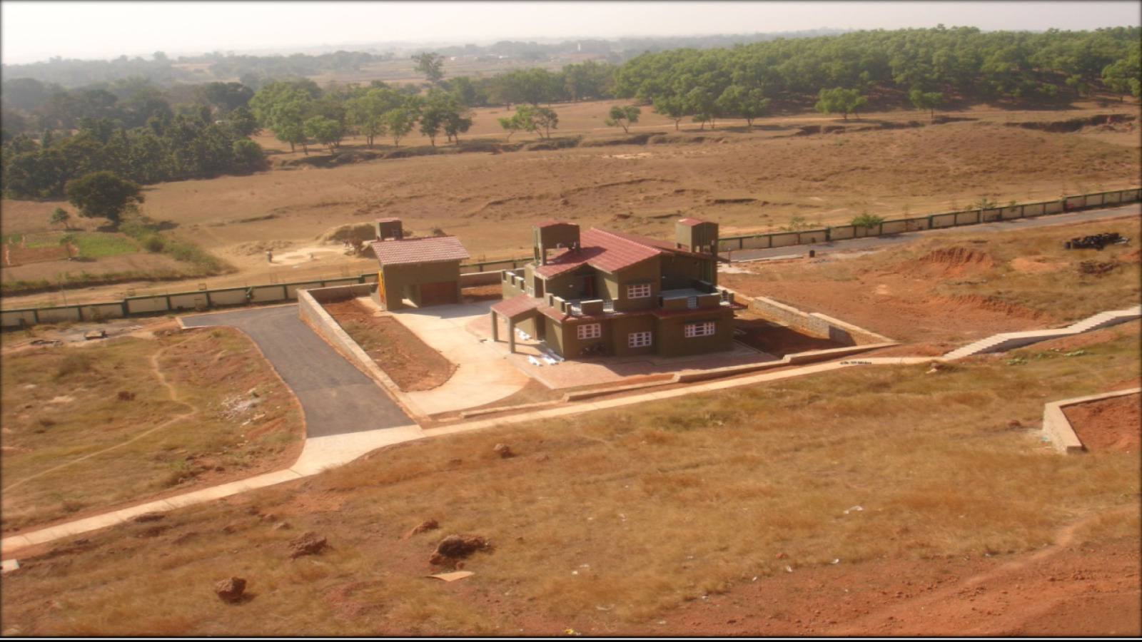

Slide 4
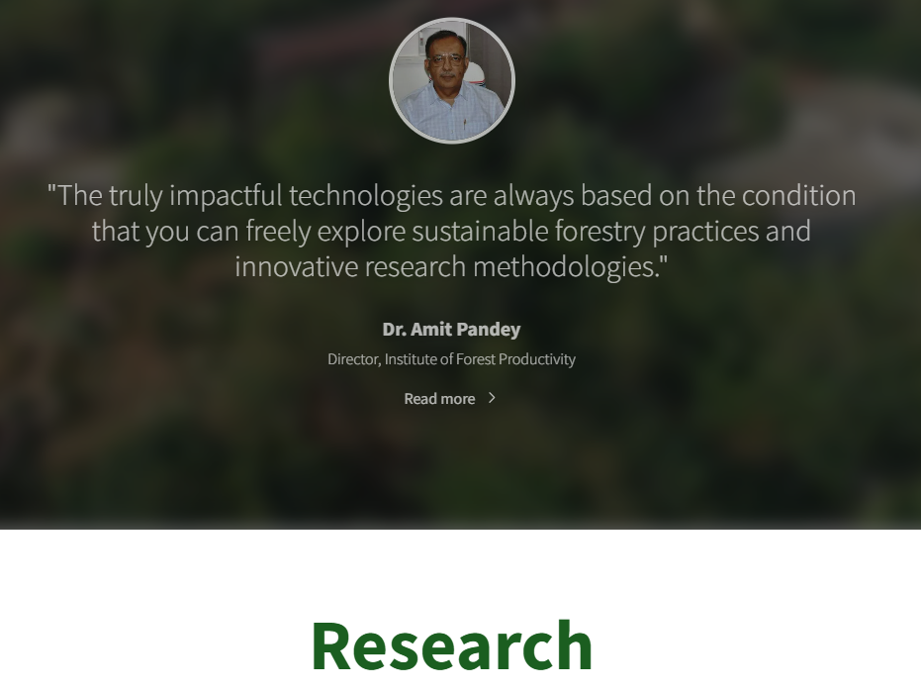
Demo photo

Slide 5
Add GCR sir photo, Dr. Yogeshwar Mishra, will change the quote after

Slide 6


Slide 7
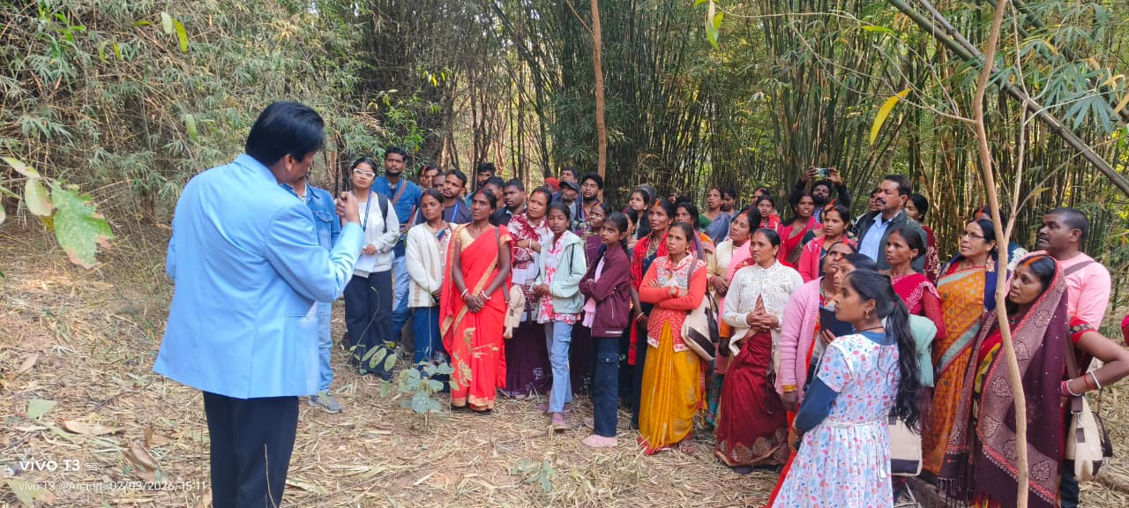
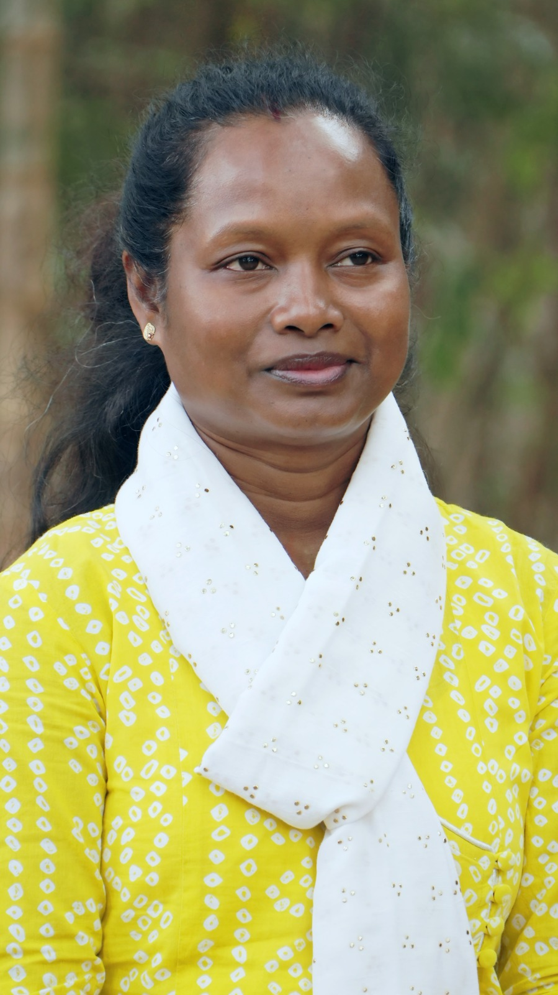
Place Ruby madam photo
Empowering communities through knowledge exchange, collaborative learning and building resilient communities.

Slide 8
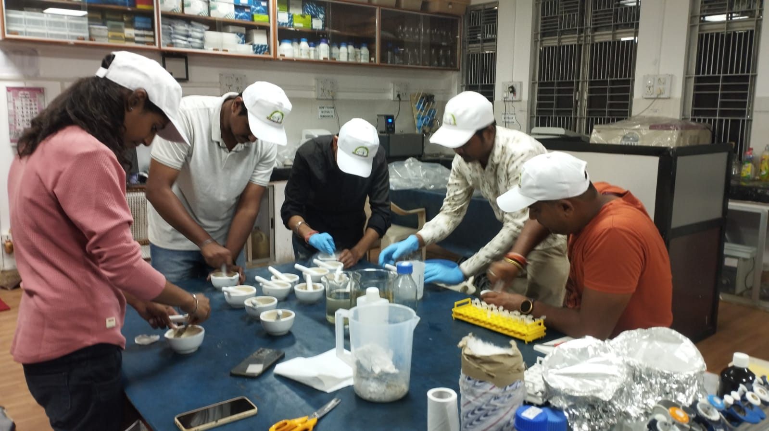
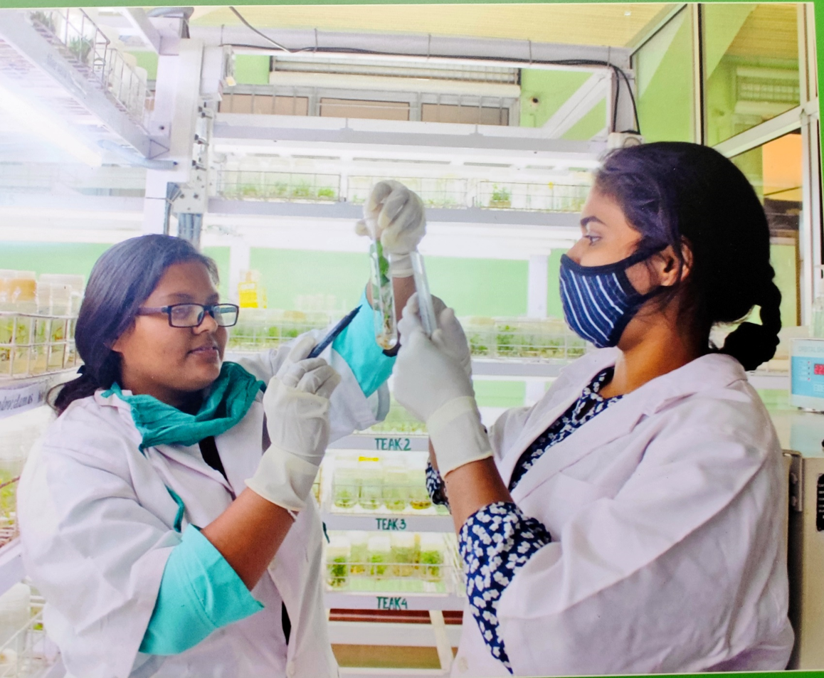
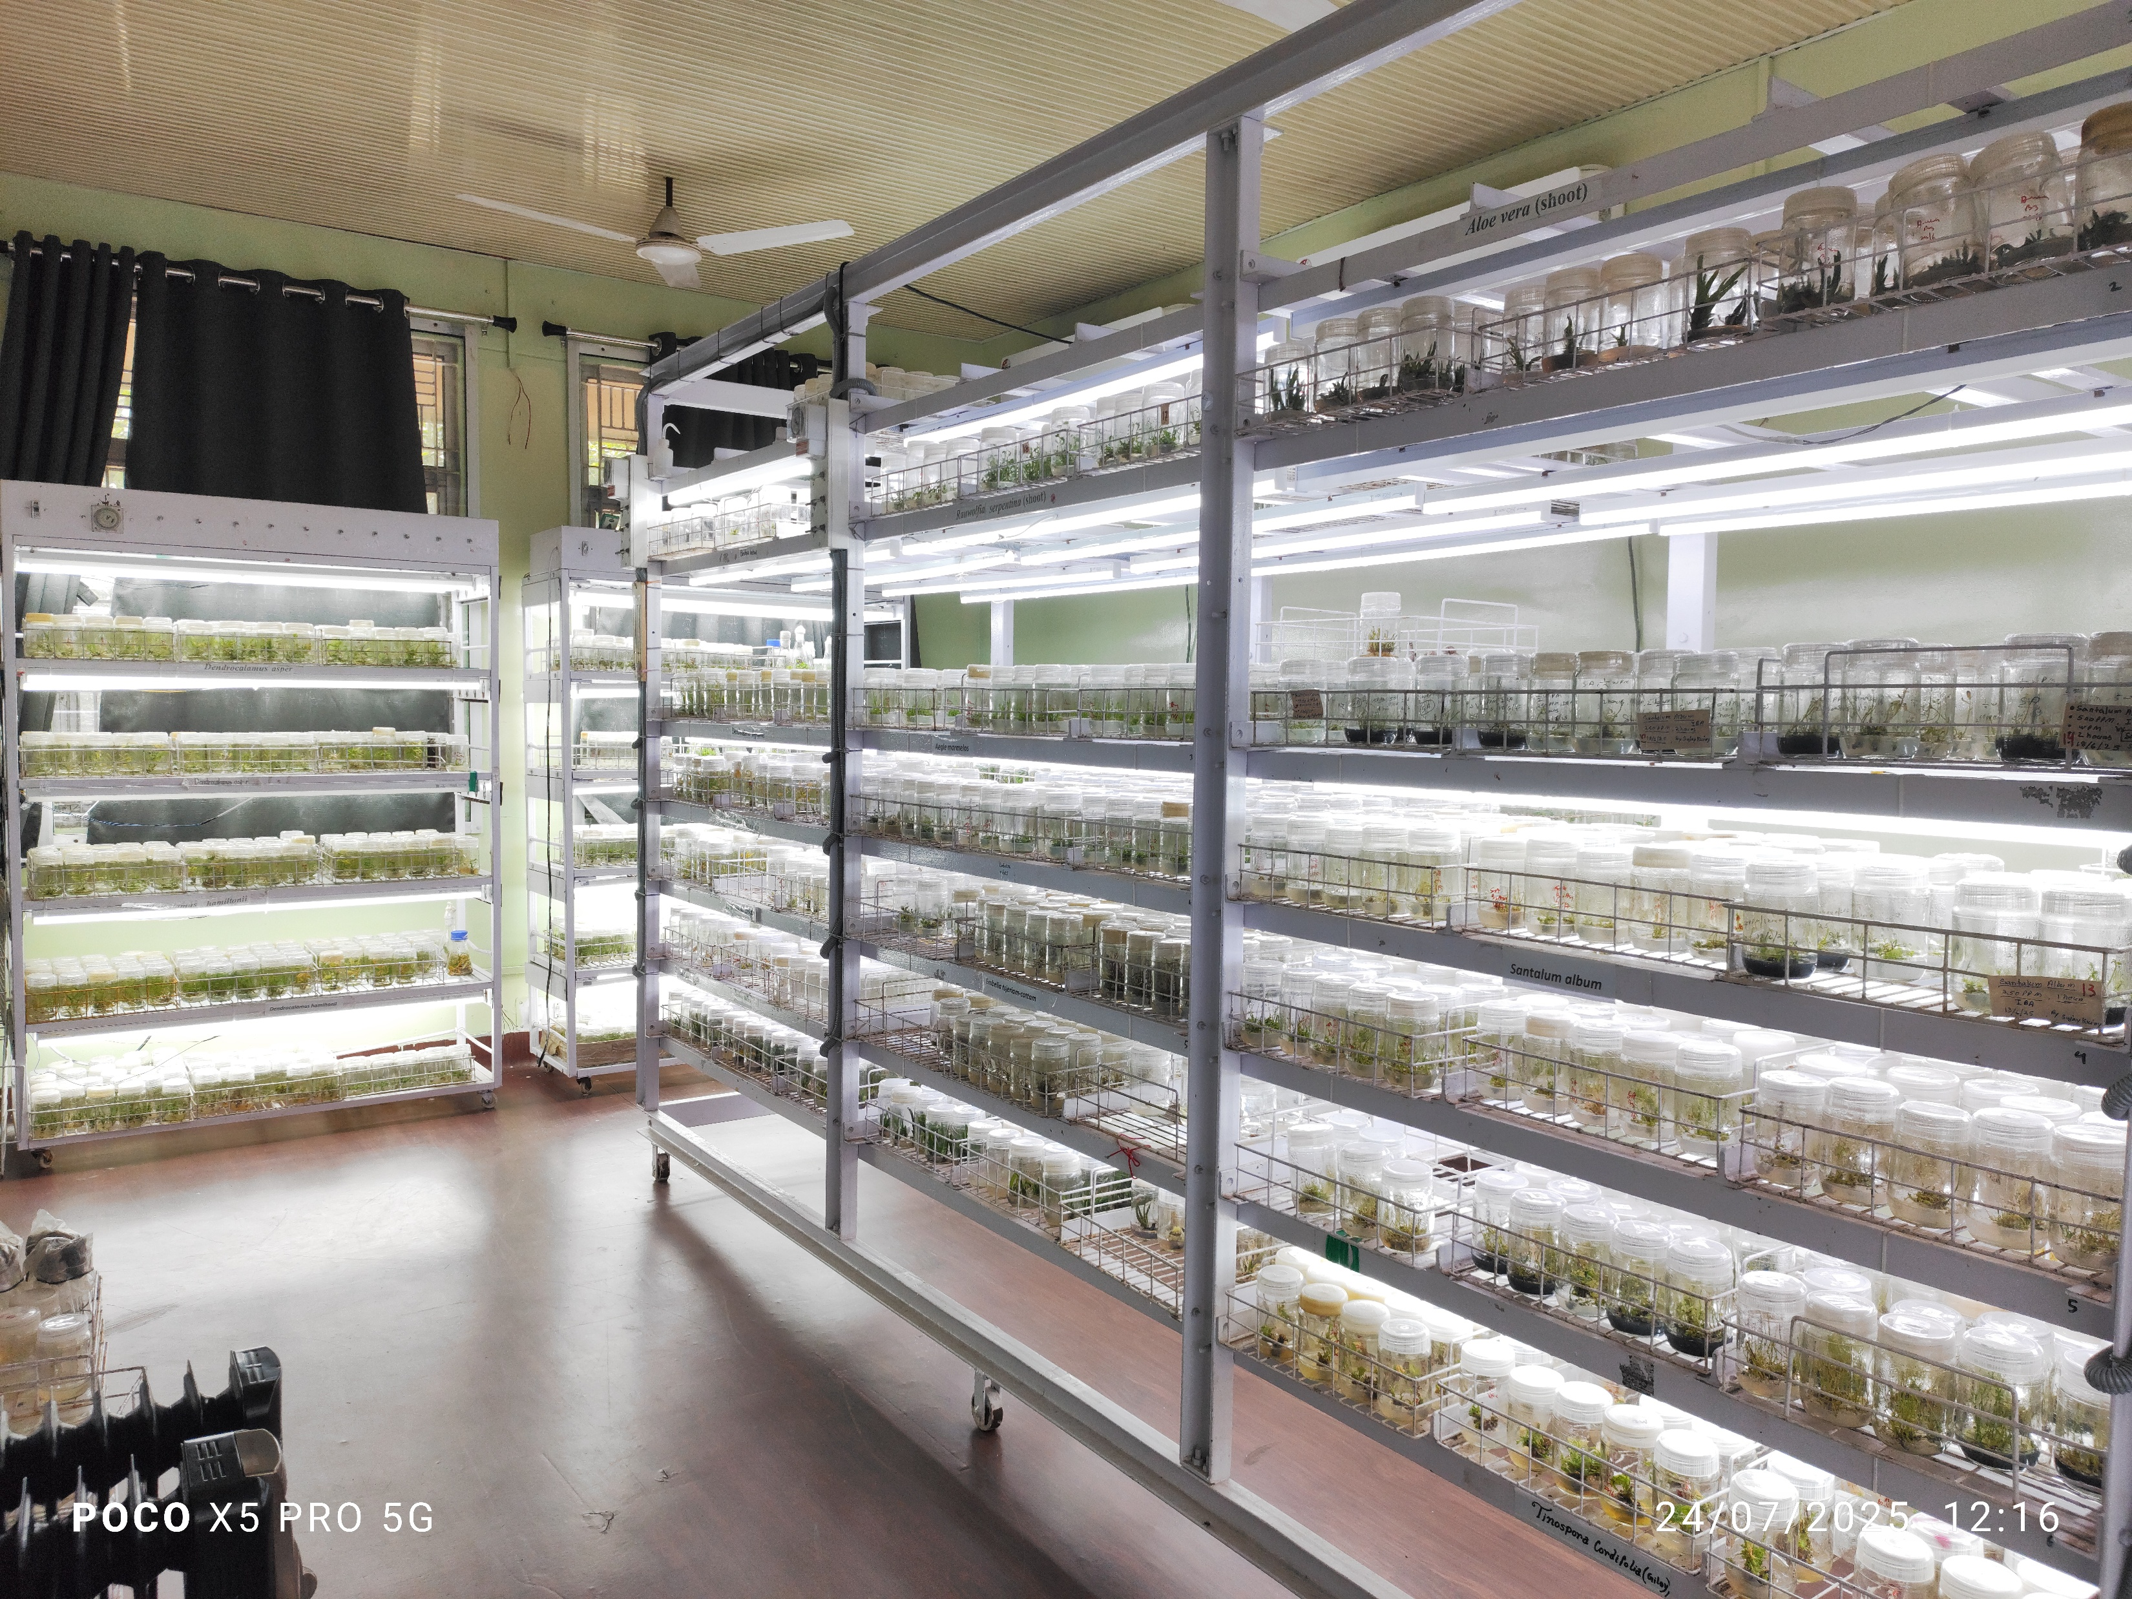
Research
Add GCR sir photo, Dr. Yogeshwar Mishra, “The backbone of scientific accountability through evaluation, tracking and reporting the assignments with precision, while transforming research outcomes into meaningful innovations that benefit both society and the environment”
Notes:
ALINE PHOTOS PROPERLY

